Slide 1
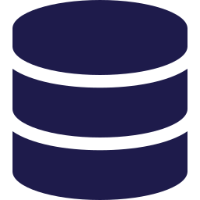



What is Cloud Computing?
CHAPTER 3
Prepared BY Assoc.Prof. James Rwigema Through “Claude AI”

Slide 2







What We'll Cover
OVERVIEW
01
02
03
04
What is Cloud Computing?
NIST Definition of Cloud Computing
Essential Characteristics of Cloud Computing
Cloud Deployment Models
05
06
07
08
Cloud Service Models
Business Drivers for Cloud Computing
Considerations for Cloud Adoption
What is Amazon Web Services?

Slide 3




Key Terminology: The Players of Cloud Computing
KEY TERMS · 1 OF 4
Data Center
Cloud User
A facility that houses and manages data: hardware (compute, storage, networks) plus software (applications, operating systems).
A person or organization requesting cloud resources and services (also called user, client, customer, or consumer).
Cloud Service Provider (CSP)
Multitenancy
An organization that provides a cloud platform, infrastructure, applications, and services.
An architecture where multiple customers (tenants) of a CSP share resources without the knowledge of one another.

Slide 4



Key Terminology: Business Words
KEY TERMS · 2 OF 4
Economies of Scale
Organizational Agility
The relationship between per-unit cost and production volume: more production spreads costs over more units, so per-unit cost falls.
The ability of an organization to quickly adapt to changes in the market or industry.
Vendor Lock-in
Barrier to Entry
Reliance on proprietary software or technology that makes it hard and costly to switch to alternatives.
An economics or business term for the obstacles a new company faces when entering a given market.

Slide 5


Key Terminology: Money Matters
KEY TERMS · 3 OF 4
CAPEX
OPEX
TCO
Capital Expenses
Operational Expenses
Total Cost of Ownership
Costs of fixed assets: their purchase, maintenance, and improvement.
Costs of the day-to-day running of a business.
The complete cost of an object or service over its lifetime, from purchase to disposal, direct and indirect.
IT example: land, computing equipment, software
IT example: Internet costs, licensing fees
Think: every cost, start to finish

Slide 6





Key Terminology: Scaling & Design
KEY TERMS · 4 OF 4
Cloud-native
Vertical scaling
Horizontal scaling
Specifically designed for the cloud environment.
Adding resources such as memory and processing power to the same node.
Adding more nodes to a distributed system.
Monolithic application
Microservices-based application
Serverless
An application designed as a single unit.
An application broken into many loosely-coupled services that interact with each other.
Independent of the need to provision or manage servers.

Slide 7
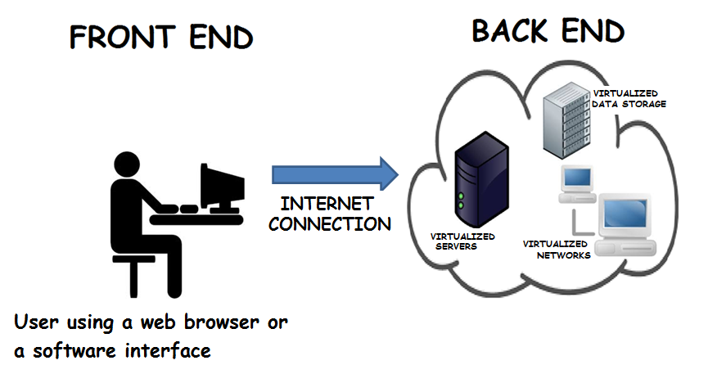
What is Cloud Computing?
CLOUD BASICS
An on-demand delivery of servers, storage, databases, applications and other IT resources as services over the Internet.
Resources are typically hosted in large data centers by CSPs such as AWS, Microsoft Azure, Google, etc., in locations across the globe. Implementation details are abstracted (hidden) from the user.
Notes:
Compare with electric and gas utilities.

Slide 8
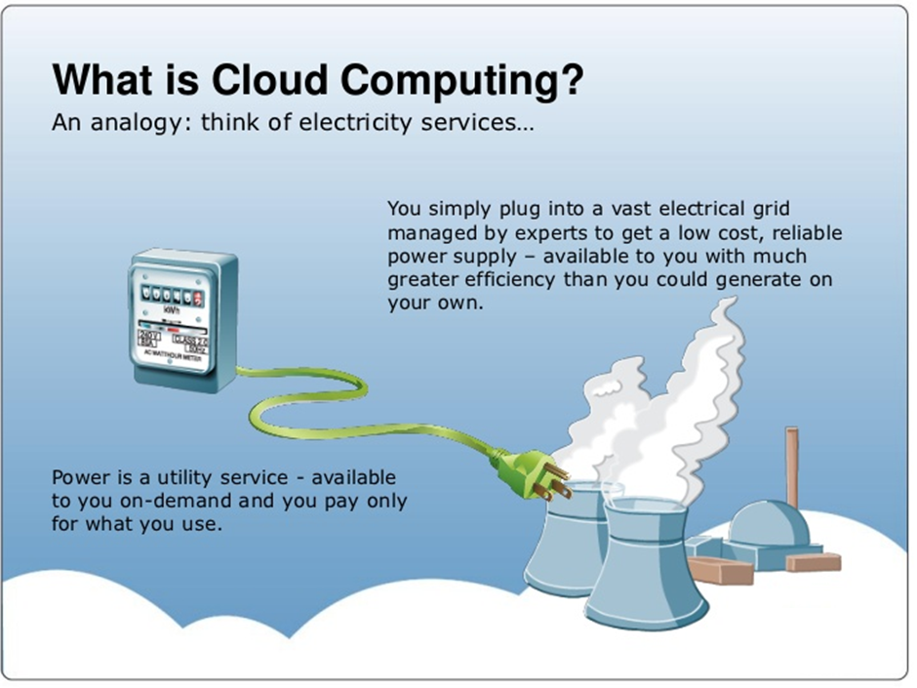


Think of It Like Electricity
CLOUD BASICS
Plug in on demand
A vast grid managed by experts: low cost and reliable.
Pay only for what you use
Metered, just like electric or gas utilities.
Use as much or as little
Consume as many or as few resources as you need.
Source: AWS
Notes:
Compare with electric and gas utilities.

Slide 9
The NIST Cloud Model
CLOUD BASICS
The US National Institute of Standards and Technology (NIST) Special Publication 800-145 is a widely accepted standard, and the premise of our next discussion. It includes the definition of Cloud Computing and describes:
5
4
3
Essential characteristics
Deployment models
Service models

Slide 10


NIST Definition of Cloud Computing
CLOUD BASICS
Cloud computing is a model for enabling ubiquitous, convenient, on-demand network access to a shared pool of configurable computing resources (e.g., networks, servers, storage, applications and services) that can be rapidly provisioned and released with minimal management effort or service provider interaction.
Common misconception
Cloud computing is not a technology. It is a business or service model that relies on enabling technologies such as virtualization and storage.
NIST

Slide 11

Essential Characteristics
NIST · 1–3 OF 5
1
2
3
On-demand Self Service
Broad Network Access
Resource Pooling
A user can provision resources as needed, automatically, without any human interaction with the service provider.
Resources are available via different client platforms such as phones, tablets, laptops, workstations, etc.
The provider creates pools of resources (servers, storage, etc.) to serve multiple consumers (multitenancy).
Notes:
Concept of pooling is the idea of abstraction that hides the location of the resources such as the virtual machines, processing memory, storage and network bandwidth.

Slide 12

Essential Characteristics
NIST · 4–5 OF 5
4
5
Rapid Elasticity
Measured Service
Resources can be provisioned or released to match demand. For example, virtual machines can be added when demand grows and terminated when demand drops.
Resource usage is monitored, controlled and reported, giving transparency to both provider and consumer. Billing is based on actual consumption: a “pay as you go” model (similar to consuming electricity).
Good to know: other terms with a similar meaning to “pay as you go” are pay-per-use.

Slide 13
Cloud Deployment Models
DEPLOYMENT MODELS
A deployment model defines who the user of that cloud is and where the cloud infrastructure resides.
Public
Private
Hybrid
Community
Open to the general public
Exclusive to a single organization
Public and private (or other) bridged together
Shared by organizations with shared concerns

Slide 14

Public Cloud
DEPLOYMENT MODELS
Infrastructure is provisioned for the general public to use.
STRENGTH
Most cost-effective through multitenancy and enormous scalability.
Exists on the premises of the CSP.
WATCH OUT
Consumers use services via the Internet and pay metered usage charges (closest to the utility model).
You don't control the location of data and equipment: a concern under regulatory mandates.
For example: AWS · Google · Salesforce

Slide 15

Private Cloud
DEPLOYMENT MODELS
For exclusive use by a single organization with multiple consumers (e.g., departments or business units).
STRENGTH
Better control over data location and security.
Infrastructure is owned and managed by the organization on-premise¹ (cost-intensive).
WATCH OUT
Requires in-house IT skills and expertise.
Limited scalability.
Preferred by companies that already own a data center and developed IT infrastructure, or are driven by legal and compliance requirements.
¹ If the organization lacks the expertise, or for cost reasons, a private cloud can also be managed by a third party and hosted off-premise.
Notes:
A use case scenario for a private cloud would be when an organization has data that cannot be put in the public cloud, perhaps for legal reasons. For e.g., they may have medical data that cannot be exposed publicly.
Another scenario may be where government policy requires specific data to be kept in-country or privately.

Slide 16


Hybrid Cloud
DEPLOYMENT MODELS
A combination of public and private (or other) cloud models.
STRENGTH
Better alignment to business needs.
The models stay unique entities but are bridged by standardized or proprietary technology that enables data and application portability.
WATCH OUT
Harder to manage.
For example: an organization with its own data center may use a public cloud for inexpensive data backup.

Slide 17
Cloud Bursting
DEPLOYMENT MODELS · HYBRID
HOW IT WORKS
Use private cloud resources to run applications. When a spike in demand exceeds local limits, the public cloud handles the burst.
EXAMPLE
A tax preparation company sees 2–3× its usual volume in tax season. Sizing on-premise for the peak leaves resources idle all year. Better: size for typical load and burst to the public cloud at peak.

Slide 18

Community Cloud
DEPLOYMENT MODELS
Provisioned for use by multiple organizations with shared concerns (e.g., mission, security requirements, policy, compliance considerations).
RUN BY
The organizations themselves or a third party.
LOCATED
On- or off-premise.
For example: US Government agencies with similar security, privacy, and audit requirements can use a community cloud.
Notes:
Salesforce has developed a CRM Community cloud solution for Higher Education.

Slide 19
Cloud Service Models
SERVICE MODELS
A service model defines the type of service that the cloud provider is offering.
Ready-to-use applications hosted in the cloud for end-users and organizations.
SaaS
e.g., Salesforce CRM, Microsoft Office 365
Software as a Service
A software platform (languages, libraries, services, tools) for developers to quickly create and deploy custom applications.
PaaS
e.g., Microsoft Azure, Google App Engine
Platform as a Service
Processing, storage, networks, and other fundamental computing resources for system administrators (IT Operations).
IaaS
e.g., Amazon EC2 (Elastic Compute Cloud)
Infrastructure as a Service
“As a service” implies that SaaS, PaaS, and IaaS are delivered by way of software.

Slide 20


Characteristics of IaaS
SERVICE MODELS · IAAS
Reduces or eliminates the capital costs and complexity of owning hardware. Why buy servers when you can rent them?
IaaS
Infrastructure as a Service
The CSP manages the infrastructure; the client is responsible for other aspects of the deployment, such as the operating system and applications.
Provision of hardware
SaaS
PaaS
IaaS is the base layer of the cloud services stack and the foundation for both PaaS and SaaS.
IaaS

Slide 21



Characteristics of PaaS
SERVICE MODELS · PAAS
An environment for low-cost, rapid development of new applications (e.g., web and mobile).
PaaS
Most platforms are accessed through an Application Programming Interface (API).
Platform as a Service
A platform to build on
Developers fully control deployed applications and hosting settings, but don't manage the underlying networks, servers, storage, or operating systems.
SaaS
PaaS
IaaS
High risk of vendor lock-in
Notes:
Leaders in the PaaS space are trying to future-proof their offerings by supporting programming using standardized and open-source languages.
Google App Engine’s PaaS application development can be conducted using standardized Java and Python as well as its own Go open-source language.

Slide 22

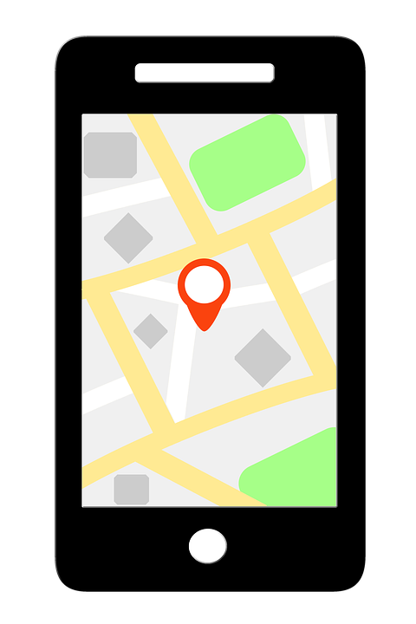
What is an API?
SERVICE MODELS · PAAS
An API allows one piece of software to talk to another.
An API defines how a programmer can write software to extend an existing application's features, or even build entirely new applications.
Source: Cisco

Slide 23
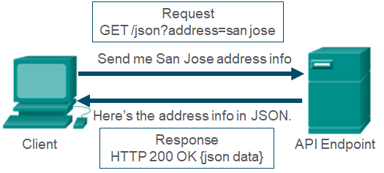
API Using HTTP
SERVICE MODELS · PAAS
Developers construct API requests using HyperText Transfer Protocol (HTTP).
1
The HTTP request asks for JSON-formatted data.
2
Source: Cisco
If correctly formatted per the API documentation, the server responds with JSON data.
3
JSON = JavaScript Object Notation

Slide 24




Characteristics of SaaS
SERVICE MODELS · SAAS
Cloud-native & multitenant
Prebuilt
Most popular service
SaaS applications are cloud-native and multitenant.
Applications are prebuilt and consumed without significant customization.
CSP does the upkeep
Just use it
Anytime, anywhere
Deployment, maintenance, patches, and updates are handled by the CSP.
Users simply use the software; they don't manage the underlying infrastructure.
Access from any client device (device and location independence).
Notes:
SaaS providers must ensure that one customer cannot access information from another customer.

Slide 25
Shared Responsibility Model
SERVICE MODELS
On-premise: the organization manages everything.
On-Premise
IaaS
PaaS
SaaS
Data
Data
Data
Data
Applications
Applications
Applications
Applications
Runtime
Runtime
Runtime
Runtime
IaaS: the CSP manages servers, storage, networking and virtualization. You manage the OS (patching and upgrades), applications, and data.
Middleware
Middleware
Middleware
Middleware
OS
OS
OS
OS
Virtualization
Virtualization
Virtualization
Virtualization
Servers
Servers
Servers
Servers
Storage
Storage
Storage
Storage
Your duties shrink from IaaS to PaaS to SaaS, but you are always responsible for your data.
Networking
Networking
Networking
Networking
Cloud customer
CSP

Slide 26



Business Drivers for Cloud
BUSINESS DRIVERS
For most businesses, IT has become a necessity. Hosting IT services in-house can be costly and distract businesses from focusing on their core competencies.
Two major business drivers for the cloud:
Lower costs
Increased agility

Slide 27

Reducing Costs
BUSINESS DRIVERS
Lower costs from economies of scale
Shift from CAPEX to OPEX (variable)
Public CSPs support thousands of customers.
Economies of scale let them offer services at reasonable prices.
Customers can choose from multiple pricing options based on workload requirements.
CAPEX
OPEX
No upfront cost of purchasing and maintaining hardware (except when on-premise).
Pay only for resources or services consumed (pay-per-use).

Slide 28

Increasing Agility
BUSINESS DRIVERS
Scalability & elasticity
Faster time to market
Scale resources up¹ or down and out² or in as needed. No more guessing, planning, or provisioning capacity.
Quickly deploy development and testing environments, and rapidly experiment, innovate, and build new products.
More focus on core business
Global access
The CSP takes over routine administrative duties, so IT staff can focus on bigger business goals.
Deploy applications in multiple regions worldwide for lower latency and a better user experience.
¹ Scaling up = vertical scaling. ² Scaling out = horizontal scaling. Using both is called diagonal scaling.

Slide 29
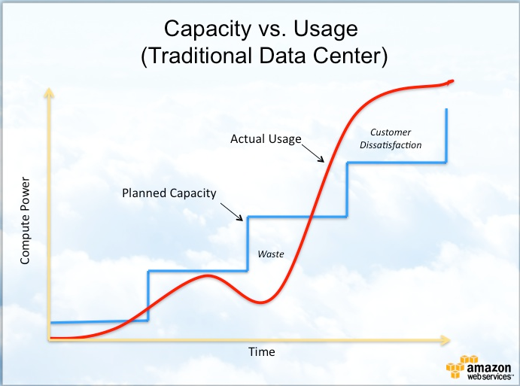
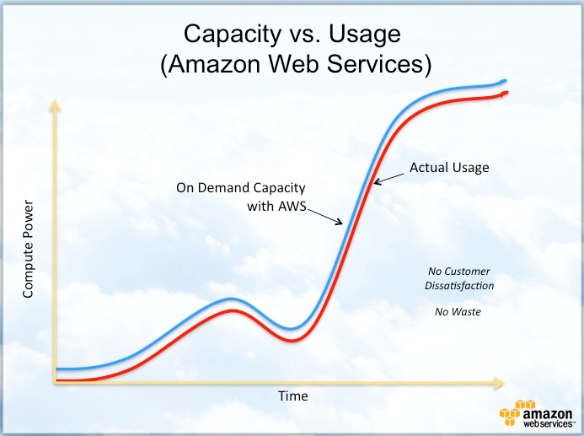
Capacity Provisioning
BUSINESS DRIVERS
Traditional data center
Cloud (AWS)
AWS closely follows the demand curve: no waste, no customer dissatisfaction.
Source: AWS

Slide 30


Choosing a Deployment Model
CONSIDERATIONS FOR ADOPTION
Organizations must consider various factors before moving their business processes to the cloud.
PUBLIC
HYBRID
PRIVATE
Startups
Small-to-medium businesses
Enterprises
The greatest barrier to entry for startups is capital. Public cloud's reduced costs outweigh other risks.
With a moderate customer base, they may prefer hybrid: mission-critical apps on a private cloud, less critical apps in a public cloud.
A large global customer base and financial strength: they may prefer private cloud to control data location, security, etc.

Slide 31



Migrate or Retain?
CONSIDERATIONS FOR ADOPTION
KEEP ON-PREMISE / PRIVATE
GOOD FIT: PUBLIC CLOUD
Mission-critical applications are best run on-premise or in the private cloud.
Regulatory and compliance requirements may prevent moving sensitive data to the public cloud.
Legacy or proprietary-technology applications should run in-house.
Apps depending on resources in a private data center may suffer latency if migrated.
Non-critical, low-risk applications:
Collaboration (email, web conferencing)
Personal productivity (word processing, spreadsheets)
Development and testing

Slide 32
Choosing a Cloud Provider
CONSIDERATIONS FOR ADOPTION
1
How long has the provider been in business?
2
Can the provider meet the current and future requirements of the organization?
3
How easy is it to add or remove services?
4
Can applications and services be easily transferred to another provider at the end of the contract?
5
Does the provider notify clients of maintenance windows, and is that downtime scheduled?

Slide 33
Is There a Cost Advantage?
CONSIDERATIONS FOR ADOPTION
Compare the TCO of an on-premise environment versus the public cloud to see whether cloud adoption pays off.
ON-PREMISE TCO
CLOUD COSTS
CAPEX: data center facilities, servers, storage devices, network equipment, operating systems, etc.
OPEX: power and cooling, personnel, Internet service, etc.
Migration costs
Usage fees for cloud services
Costs to ensure security and compliance
Free tools: AWS TCO calculators, and the AWS Pricing Calculator to estimate AWS service costs.

Slide 34


Migration Strategies
ADOPTION · STRATEGIES 1 OF 2
Review existing applications and pick the strategy that best matches business needs: cost savings, scalability, availability, etc.
Rehosting (Lift-and-shift)
Re-platforming
FASTEST
Redeploy on-premise applications into cloud IaaS.
Meets business needs quickly, with no optimizations.
Fastest, but does not use the cloud's full potential.
Manual or automated, e.g., AWS VM Import/Export (VM images to Amazon EC2).
Optimizations without changing the core architecture.
Example: move an on-premise database to a fully managed service such as Amazon RDS, so the CSP handles most administrative tasks.

Slide 35


Migration Strategies
ADOPTION · STRATEGIES 2 OF 2
Repurchasing
Rebuilding / Re-architecting
MOST EXPENSIVE
Invest in SaaS (cloud-native) applications, i.e., move to a different product.
Frees IT staff from maintenance and updates.
Examples: HR system to Workday, Outlook to Office 365, in-house CRM to Salesforce.
Change the core architecture, e.g., turn a monolithic application into microservices, or go serverless (more in Chapter 3).
Goal: a considerable increase in performance, scale, agility, or new features.

Slide 36



Service Level Agreements
CONSIDERATIONS FOR ADOPTION
An SLA is a contract between a customer and a CSP that specifies the level of uptime the provider will support, as well as the expected performance metrics.
Should say how the CSP compensates customers if SLAs are not met (e.g., money or service credits).
Specific to a cloud service: storage and virtual machines can have different SLAs.
Can be uniform for all customers, or a custom agreement between one customer and the CSP.
Helps ensure key resources stay available so organizations avoid excessive losses.

Slide 37
Example: AWS EC2 SLA
CONSIDERATIONS FOR ADOPTION
For each Amazon EC2 instance, AWS will make commercially reasonable efforts to keep it available at least 99.5% of the time in any monthly billing cycle. If it falls short, you can receive a Service Credit.
UPTIME THIS MONTH
SERVICE CREDIT
99.0% to < 99.5%
10%
95.0% to < 99.0%
30%
An EC2 (Elastic Compute Cloud) instance is synonymous with a virtual machine deployed in the AWS cloud.
Below 95.0%
100%
Instance-level SLA published by AWS. Source: AWS

Slide 38

Current Trend: Multi-cloud
CONSIDERATIONS FOR ADOPTION
Each vendor offers a myriad of services, and one vendor's service may beat the others on performance, ease of use, cost, compliance, etc.
Multi-cloud
Using cloud services from more than one cloud vendor.
Flexibility to choose the best-fit service from each vendor, and it may also prevent vendor lock-in.
AWS
Azure
Very appealing, but the obvious pitfall is management complexity.
Google

Slide 39


What is Amazon Web Services?
AWS
March 2006
#1
Core services over its Global Infrastructure of Regions, Availability Zones, and Edge Locations: compute, storage, database, networking, and more.
AWS was founded
World's largest public cloud provider today
Three ways to access AWS
Management Console
Command Line Interface
SDKs
Think of it as a GUI.
The CLI allows scripts.
Preferred by developers. Python, Java, PHP, Ruby, C++, etc.

Slide 40
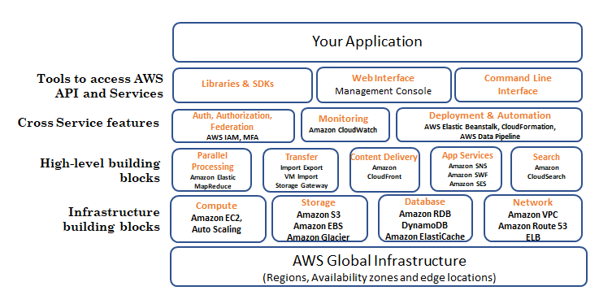

AWS Services at a Glance
AWS
Read it bottom-up
Your application sits on top of AWS services, which run on the AWS Global Infrastructure.

Slide 41
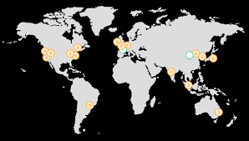
AWS Regions
AWS · GLOBAL INFRASTRUCTURE
The AWS footprint consists of several geographic Regions spread across the globe.
Each Region has multiple, physically separate Availability Zones. The typical number is three.
Learn more: AWS Regions and Availability Zones
Source: AWS

Slide 42
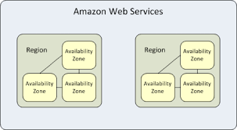



Availability Zones
AWS · GLOBAL INFRASTRUCTURE
An Availability Zone is a cluster of one or more discrete data centers.
AZs are powered independently of other AZs in the Region.
They are separated by about 100 km (60 miles).
Source: AWS
If one AZ is hit by a power outage or a disaster (earthquake, tornado), the other AZs stay unaffected.
AZs in a Region are linked by high-throughput metro fiber.
Notes:
The physical distance between the AZs guarantees that if an issue such as a power outage or a natural disaster such as an earthquake, tornado, etc., were to impact an AZ, the others AZs will remain unaffected.

Slide 43
Chapter Recap
KEY TAKEAWAYS
5
Essential characteristics
4
Deployment models
3
Service models
On-demand self service
Broad network access
Resource pooling
Rapid elasticity
Measured service
Public
Private
Hybrid
Community
SaaS
PaaS
IaaS
Cloud computing is a business and service model, not just a technology.

